Slide 1
Intro to Spatial Data & Maps in R Beth Boettner Research Scientist, IPR boettner.6@osu.edu November 2nd, 2023

Slide 2
Agenda
Finding & Opening Spatial Data
Points, Polygons, Polylines
Setting Coordinate Reference System/Projection
Mapping Basics
GGplot2 vs Leaflet
Choropleth Maps – using color to visualize amounts/counts/characteristics
Simple Manipulations
Spatial Joins
Calculating Distances or Buffers
Selection by Location using Buffer

Slide 3
Finding & Opening Spatial Data
Points:
Any data source with X and Y saved as individual column vectors (if not, use string functions to split)
Polygons & Polylines:
Existing shapefile (.shp and associated files) from another source
Can use API tools to get Census shapefiles directly in R (tidycensus & tigris from Kyle Walker)
Packages:
sf (simple features): newest R package for spatial data, increasingly integrated into other tools (tidyverse) and becoming dominant
sp

Slide 4
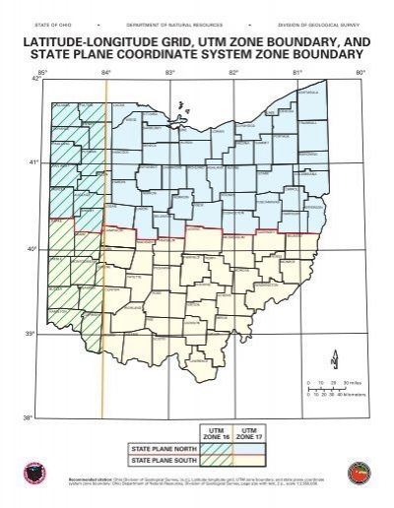
Setting Coordinate Reference System (CRS) /Projection
World is a sphere so our maps are 2D representations of that
Setting CRS is very important to ensure mapping is correct, and for correct calculation of overlaps or distances (esp important is distances cover larger geographic areas)
CRS = 4326 is WGS 1984; best used for latitude and longitude
State plane systems cover smaller geographic area; shapefiles of local area may come in this
CRS = 3735 for Ohio State Plan South covers Franklin County
Use sf:: st_transform() to change projection as needed

Slide 5
Mapping Basics
Ggplot2 has a geom_sf() that will display sf data, using the same conventions for color and fill options that other items in ggplot use
Ggplot will use the projection of the first item added, and project the others, so you don’t have to transform CRS for this; other functions may require it though
Leaflet can help you make interactive maps for posting to the web or just to make data exploration easier to see the road network or other features
All objects to be mapped must be in CRS 4326 (WGS84)

Slide 6
Spatial Joins
find out which polygon contains which points, attach polygon characteristics to individual points
St_join(x, y) → st_join(points, polygons)
Will return a dataframe of the points, with corresponding columns from the polygons file, if the point is located within a polygon
Retuns only the joins; add left = TRUE if want to keep all points
st_join(points, polygons, left = TRUE)

Slide 7
Buffers & Distances
Make a buffer of a certain distance around a point; helpful for identifying points in another set that fall within a certain distance
St_buffer()
need to make sure sf object is in a CRS that is measured in feet or meters (not degrees) so you can give the cutoff you want to use in that unit
Calculate distances from every point in x to a single point in y or get a matrix of distances if two sets of points
St_distance(x, y)
Distance from each point to previous point in the same frame using geodist() - I use this for consecutive GPS points
dist <- as.data.frame(geodist(xypoints, sequential = TRUE))
colnames(dist)[colnames(dist)=="geodist(xypoints, sequential = TRUE)"] <- "distprevm"

Slide 8
Resources
Tidycensus
https://walker-data.com/tidycensus/
Geocoding:
https://jessecambon.github.io/tidygeocoder/
Leaflet:
https://rstudio.github.io/leaflet/
Mapping Guides
https://r-spatial.org/r/2018/10/25/ggplot2-sf.html
https://cengel.github.io/R-spatial/mapping.html

